Slide 1




The Impact of Imputation Quality on Family-Based Analyses
Mahdi Mir (UCLA & SSGAC) Alexander S. Young (UCLA & SSGAC) Oct 2024

Slide 2
Motivation
We are concerned that the low-quality imputed genotypes may not be suitable for family-based analyses.
Family-based research designs rely on special properties of the data.
We are interested in understanding the impact of imputation quality on downstream analysis by comparing to the WGS data.
Notes:
Our motivation is

Slide 3
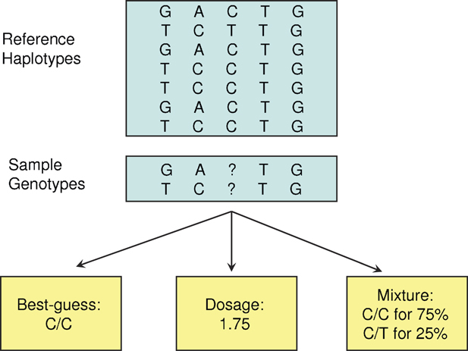
Reference Based Imputation
Hard Call
Source: Zheng et al. (2011)

Slide 4
Reference Based vs Mendelian Imputation
Mendelian imputation, as implemented in SNIPAR (Young et al., Nature Genetics, 2022), differs entirely from reference-based imputation.
Reference-based imputation does not consider the relationships between individuals and performs the imputation for everyone separately.

Slide 5
Correlation Analysis in UK Biobank
Info Score: Imputation Quality
UK Biobank Imputed Data
SNPs with MAF > 1%
Info Score > 30%
70K SNPs
White British Subsample
19K Full Siblings Pairs
4K Parent-Offspring Pairs
Howe et.al (2022) Sib-GWAS used low-quality imputed SNPs (Info Score > 30%).

Slide 6
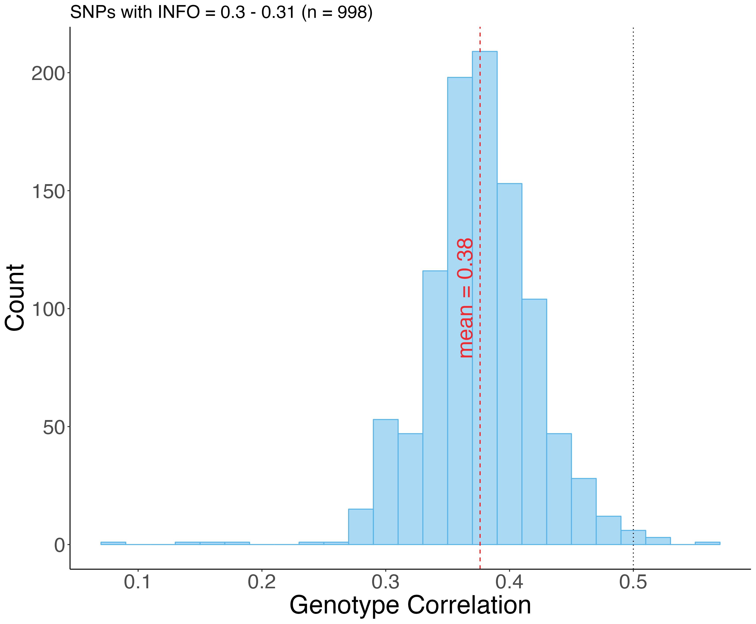
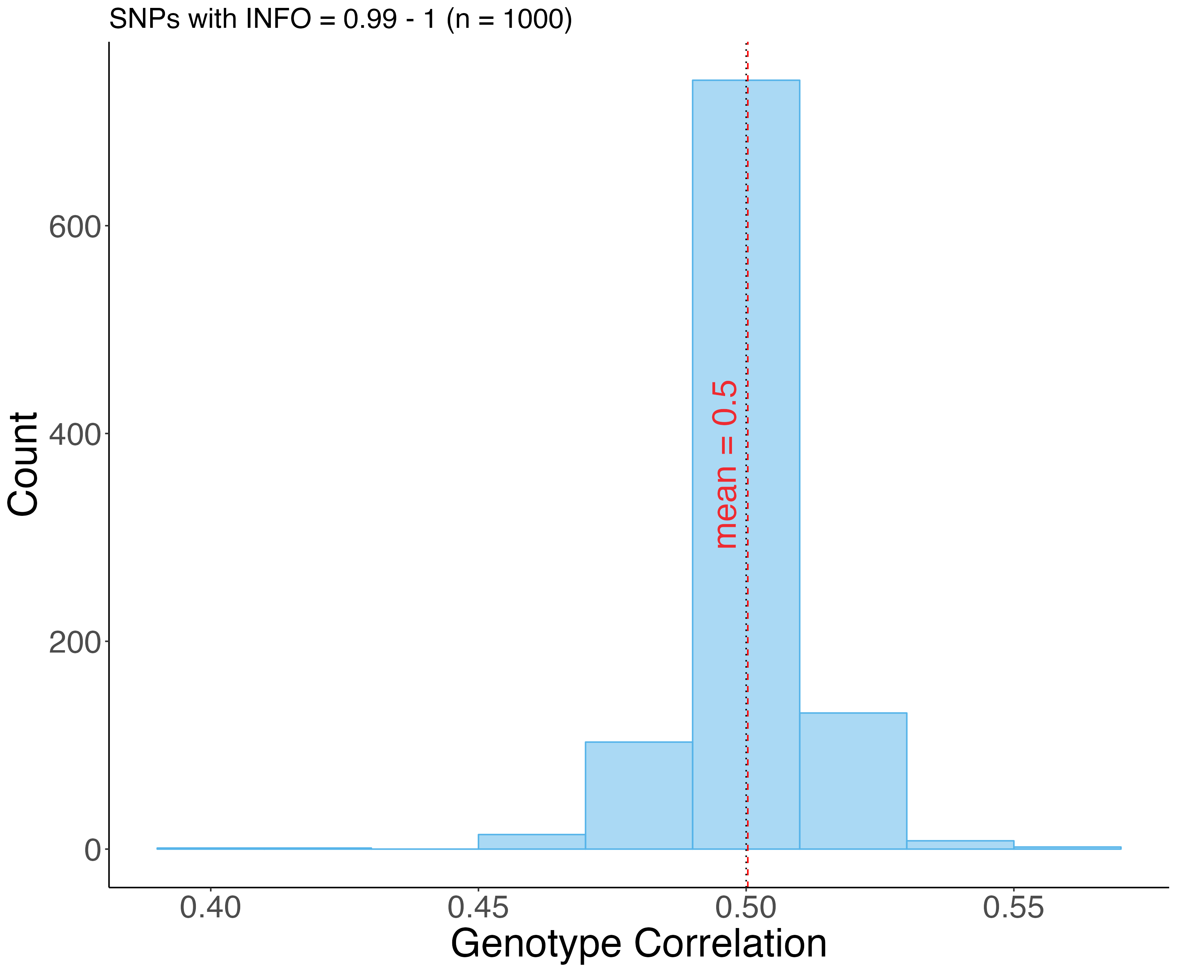
Correlations Distribution – Full Sibs
Low Quality Imputed
High Quality Imputed

Slide 7
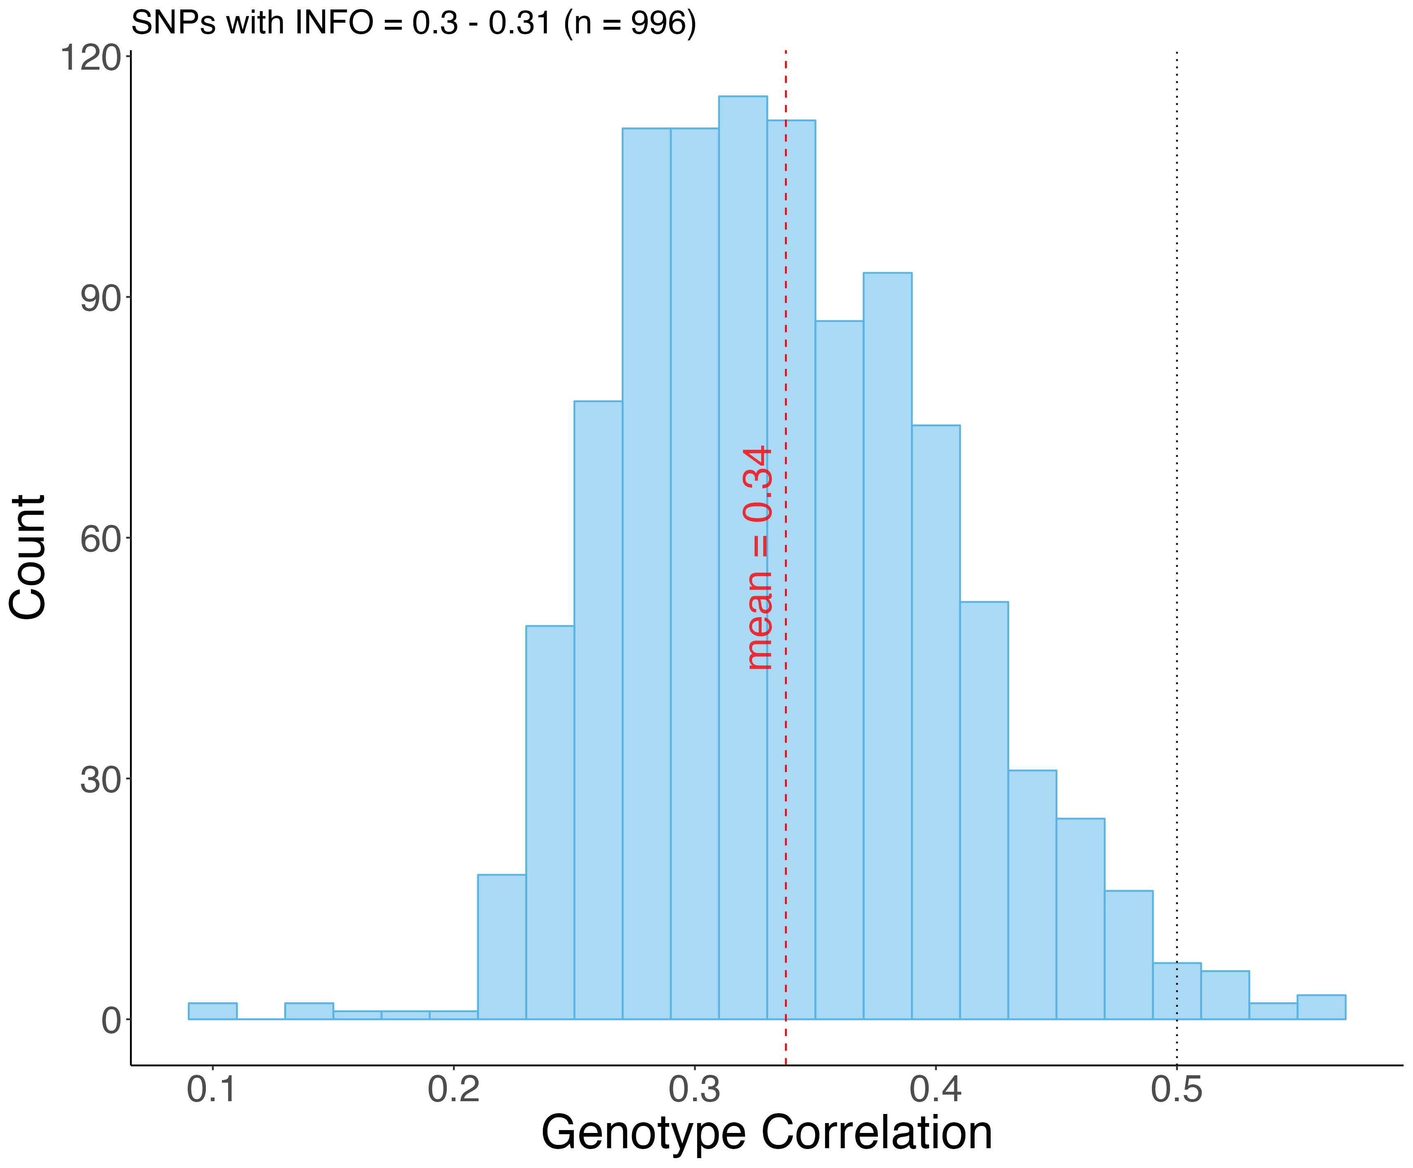
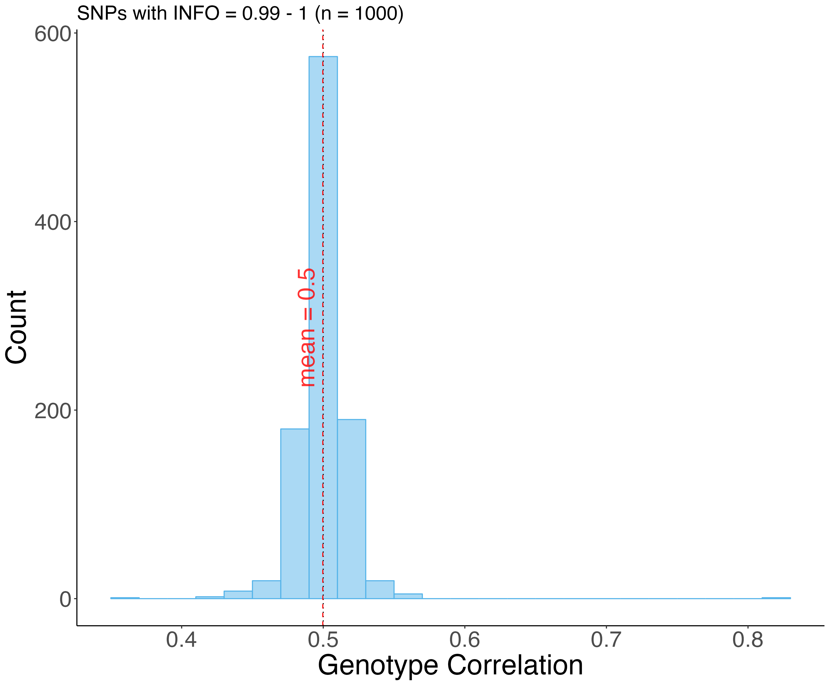
Correlations Distribution – Parent-Offspring
Low Quality Imputed
High Quality Imputed

Slide 8
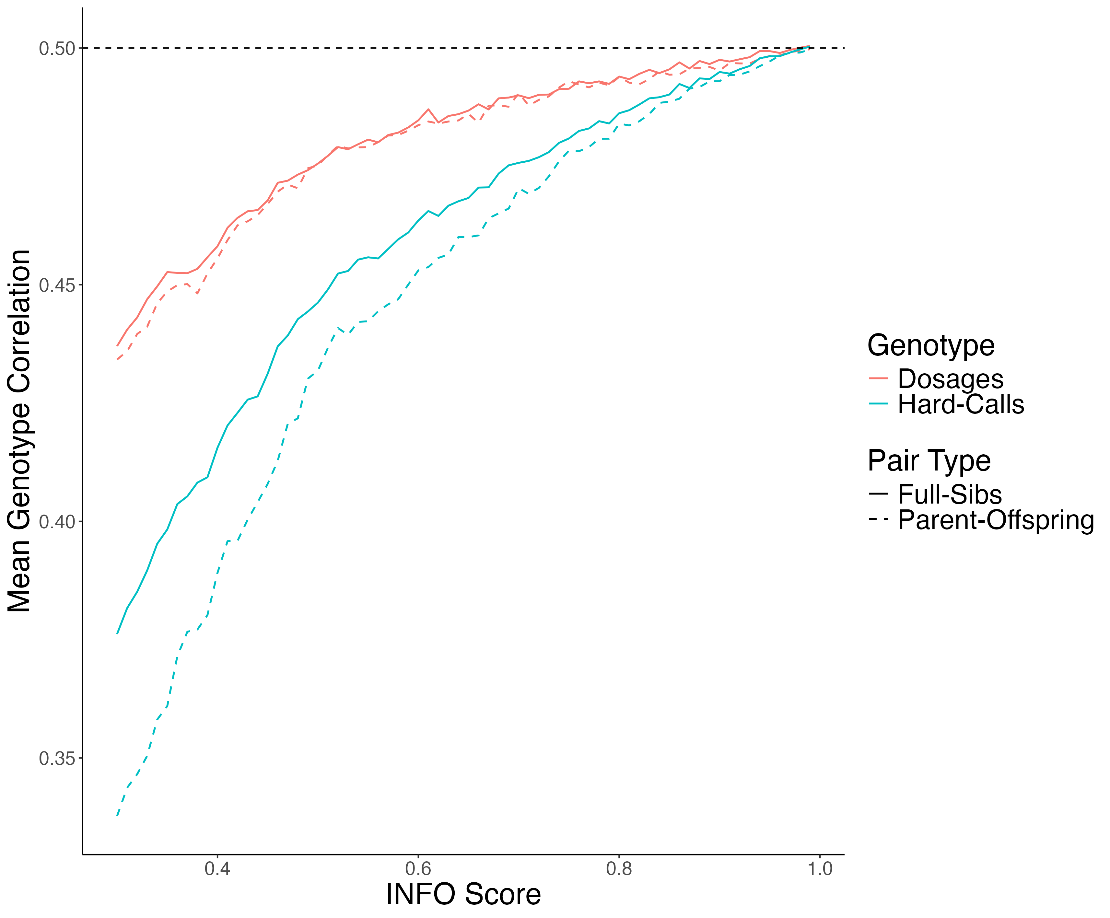
Mean Genotype Correlation

Slide 9
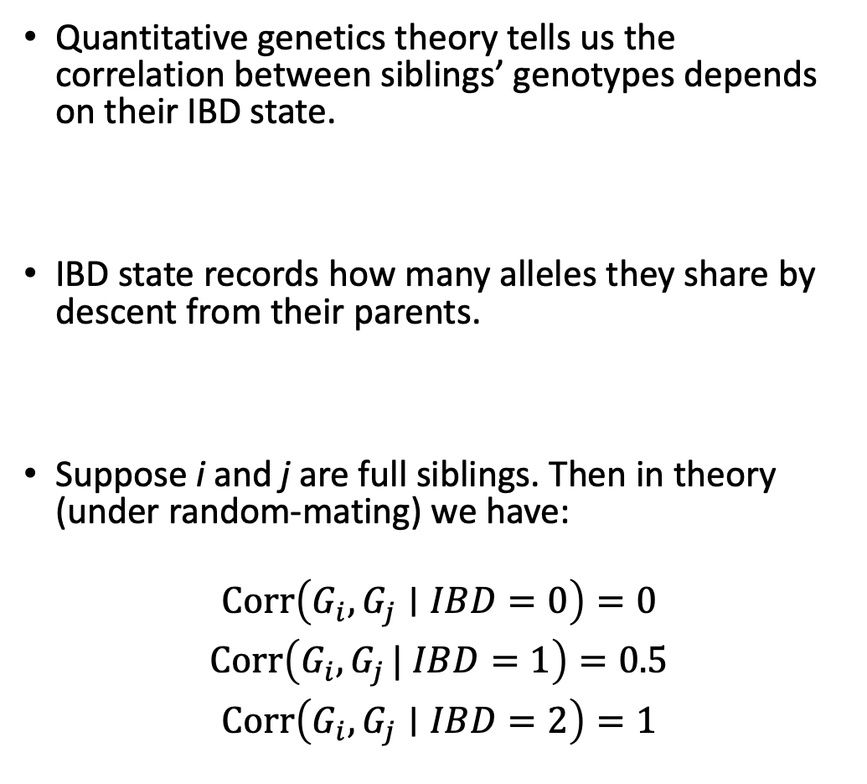
Correlation Analysis Conditional on IBD States
Quantitative genetics theory tells us the correlation between siblings’ genotypes depends on their IBD state.
IBD state records how many alleles they share by descent from their parents.
Suppose i and j are full siblings. Then in theory (under random-mating) we have:
$$\begin{matrix}Corr⁡\left(G_{i},G_{j}∣IBD=0\right)=0 \\ Corr⁡\left(G_{i},G_{j }| IBD=1\right)=0.5 \\ Corr⁡\left(G_{i},G_{j}∣IBD=2\right)=1\end{matrix}$$

Slide 10
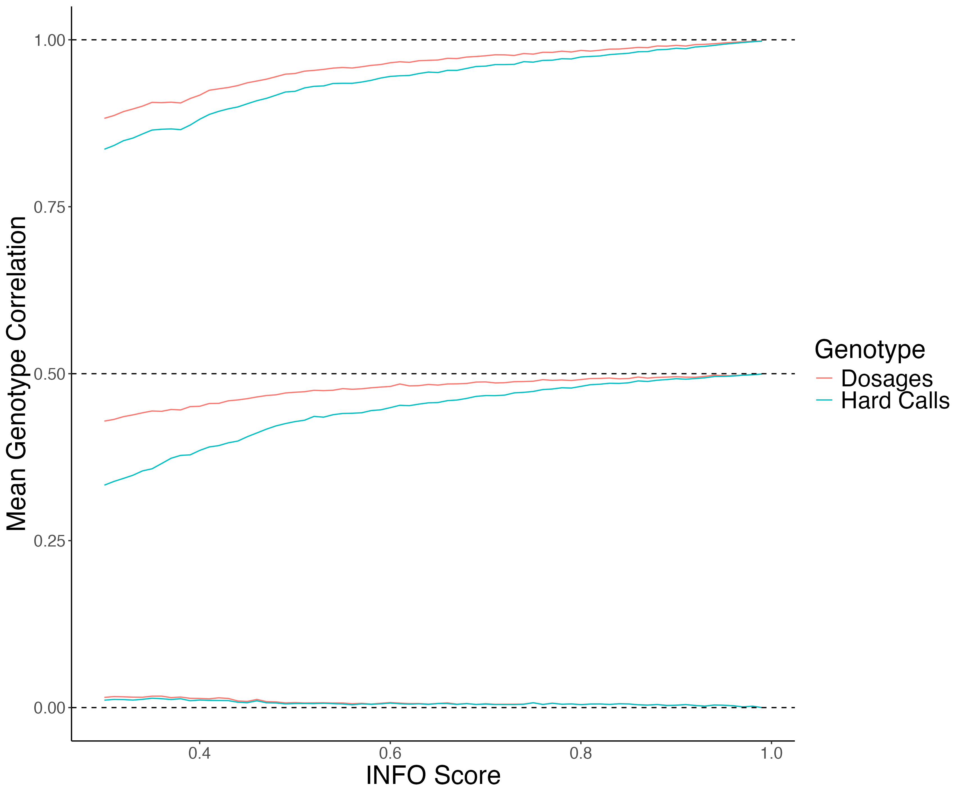
Mean Imputed Genotype Correlation Conditional on IBD State

Slide 11
Mean Imputed Genotype Correlation Conditional on IBD State
IBD = 2

Slide 12
Mean Imputed Genotype Correlation Conditional on IBD State
IBD = 1

Slide 13
Mean Imputed Genotype Correlation Conditional on IBD State
IBD = 0

Slide 14

Conclusion
Genotypes imputed from a reference panel do not preserve Mendelian laws except for the very highest quality imputed variants.
This is worse for Hard Calls (Best Guesses) genotypes than for dosages, and it is worse for parent-offspring compared to full siblings.
We are working on the WGS data to see what is the the downstream effect of using low-quality imputed genotypes in Family-Based analyses.
Also, we are interested in developing reference-based imputation methods that considers the relationships between the individuals and Mendelian laws.

Slide 15
THANK YOU!

